Slide 1

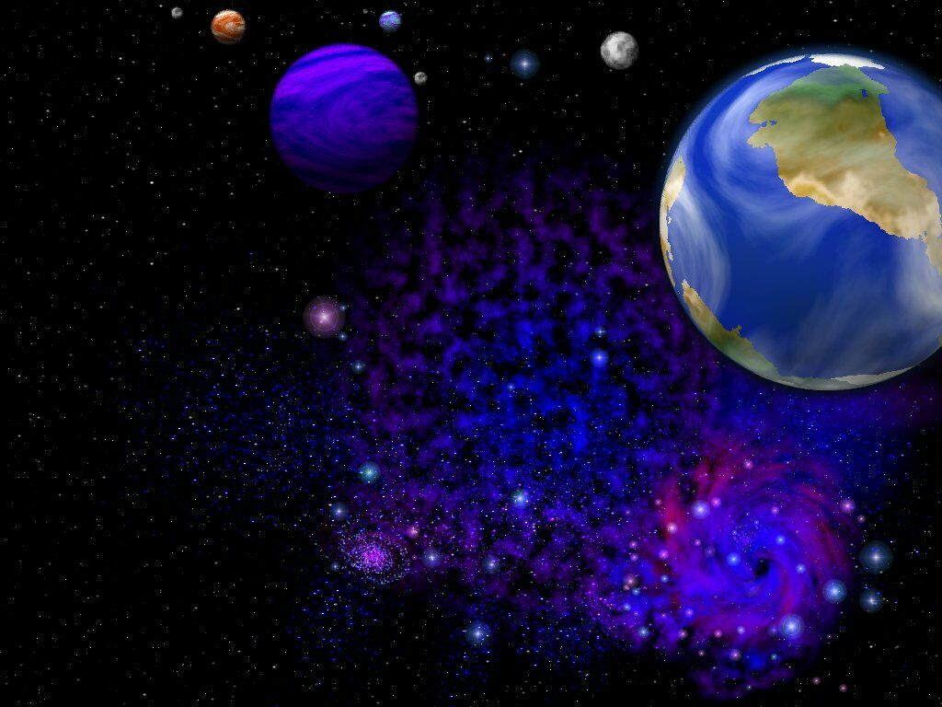
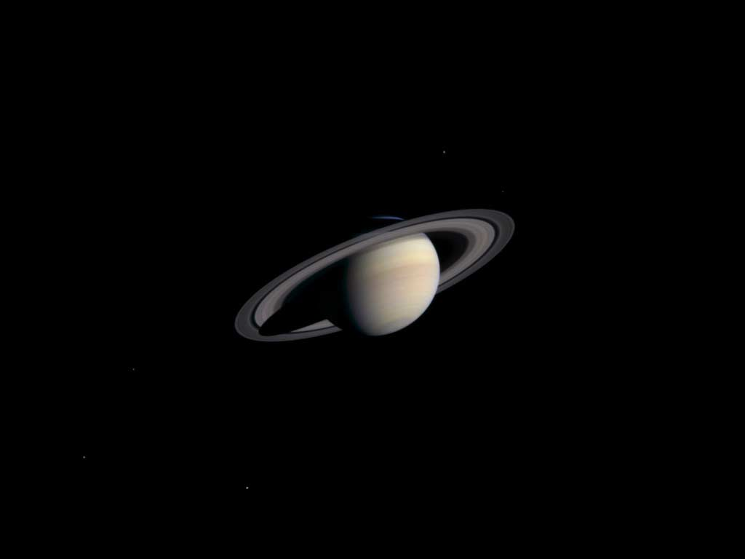


高中第八册
Module 5
The Conquest of the Universe

Slide 2
Language Points

Slide 3

1. Ever since Neil Armstrong first set foot on the Moon back on 21st July, 1969, people have become accustomed to the idea of space travel.
自从尼尔·阿姆斯特朗在1969年7月21日首次踏上月球以来，人们对太空旅行这一概念已经非常熟悉。

Slide 4
set foot on/in
“踏上；进入/到（某处）”
She left him and determined never to set foot in that house again.
她离开了他，下决心再也不踏进那间房子。
The overseas are very glad to set foot on their homeland.
华侨们非常高兴地踏上祖国的土地。

Slide 5
“be/get/become/grow accustomed to+名词/代词/动名词” 习惯于
My elder sister has grown accustomed to looking after me.
我姐姐已经习惯于照顾我。
You will soon get accustomed to the weather here.
你很快就会适应这里的天气的。

Slide 6
2. Millions of people watched that first moon landing on television, their hearts in their mouths, aware of how difficult and dangerous an adventure it was, and what risks had to be taken.
数以百万计的人们从电视上观看了首次登月，他们的心提到了嗓子眼，因为他们十分清楚这次是多么艰难多么危险，以及要冒多么大的风险。

Slide 7
hearts in their mouths 在此处为独立主格
非常紧张，提心吊胆
When the bear came out of the woods towards us, our hearts were in our mouths.
当熊走出树林，向我们走过来时，我们非常害怕。

Slide 8
形容词aware 常跟of引起短语，充当表语或状语等。
It was several minutes before he was aware of what was happening.
几分钟之后，他才意识到发生了什么。
The driver sat there motionlessly, aware of how serious the traffic accident was.
司机一动不动地坐在那儿，他明白这场交通事故有多么严重。

Slide 9
3. the average school students
average:一般的，普通的
He is just an average student.
他只是一个普通的学生。
An average six-year-old child could understand it.
这是普通6岁的小孩就能理解的。

Slide 10
4. It was a success.
success 为抽象名词具体化
He is a success/failure.
他是个成功/失败的人。
The movie actress turned out an overnight success.
那位电影演员竟一夜走红。
Everything cooperated to make our holiday a success.
这一切凑合起来使我们的假期圆满过去。

Slide 11
5. By the time the Challenger took off in 1986, the world seemed to have lost its fear and wonder at the amazing achievement of people going up into space.
到1986年“挑战者”号起飞之前，人们似乎已经沉醉于人类走进这一巨大成就而忘记了恐惧，也失去了好奇。

Slide 12
动词seem 后面跟不定式的不同形式 :
to do, to be doing, to have done
表示动作发生的时间不一样
You seem to know his telephone number.
你好像知道他的电话号码。
They seem to be carrying out a space experiment.
他们似乎正在从事一项太空实验。
He seems to have passed the driving test.
他好像已经通过了驾驶考试。

Slide 13
6. But this was going to be a special flight and so millions of people tuned in to witness the take-off on TV.
但是这次却将是特殊的飞行，数百万人打开了电视来一睹这次起飞。

Slide 14
tune in
1）拨到某个电台，收听某台节目
2）把……调到（某台），收到（某台）
He turned on the radio and tuned in to the BBC.
他打开收音机，收听英国广播公司的节目。
Some nights I can tune in that station easily; other nights I can’t tune it in at all.
有的晚上，我能很容易地收听那个电台，有的晚上却压根儿收不到。

Slide 15
witness:
cn. 目击者，见证人 + to/of
The police found the witness to the murder case.
警察找到了那件谋杀案的目击者。
vt. 目击……，亲眼看到
Did you witness the accident?
你亲眼看到那次事故了吗？
作证，证明
He witnessed the truth of my statement.
他证明了我的陈述真实。

Slide 16
7. The world was in shock -- maybe they assumed this space flight would be no more dangerous than getting on an aeroplane.
全世界都震惊了---也许人们原本都认为这次太空飞行跟乘坐飞机一样没什么危险。

Slide 17
assume v. 假定，假设
----I assumed that he was dead.
----I assumed so.
--我认为他死了。
--我也这么认为。
Assuming that his story is true, what should we do?
假定他的话是真的，我们该怎么办？
assume +名＋（to be）+名/形
I assumed him (to be) an honest man.
我认为他是个诚实的人。

Slide 18
no more dangerous than=as safe as
His French is no better than mine. =His French is as poor as mine.
Mr. Pan is no taller than Wu Dalang.=
Mr. Pan is as short as Wu Dalang
潘先生和武大郎一样矮。
8. in a state of shock
处于惊呆的状态
He was in a poor state of health.
他的健康状况不佳。

Slide 19
In spite of all our advanced technology, the world is still only at the very beginning of its voyage into space.
即便我们掌握了现在的全部先进技术，我们这个世界依然只是处于太空旅行的起步阶段。

Slide 20
in spite of “尽管”
In spite of all his efforts, he failed in the exam.
尽管他很努力，但还是没有通过考试。
In spite of the heavy snow, he drove downtown.
尽管下着大雪，他还是开车去了城里。
despite
Despite his serious illness, he attended the conference.
尽管病的很严重，他还是参加了会议。

Slide 21


Thankyou！

